Slide 1

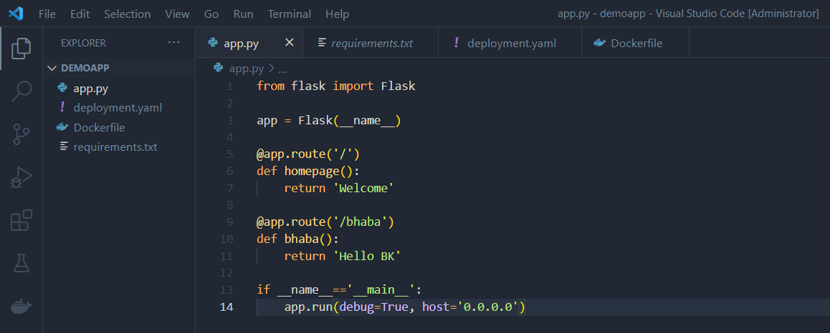
Deploying sample application to Kubernetes
1) Create a folder with any name (For example: demoapp) and open it in VS Code as admin.
2) Create the application file inside the folder (For example: app.py).

Slide 2
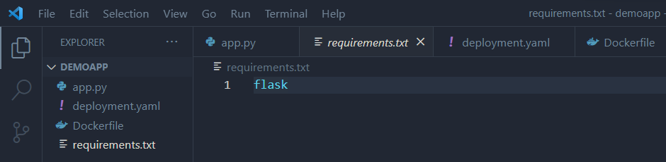
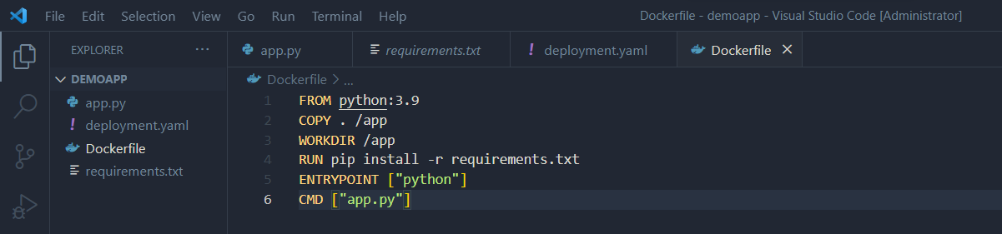
3) Create a requirements.txt file for it.
4) Create a Dockerfile for it.

Slide 3
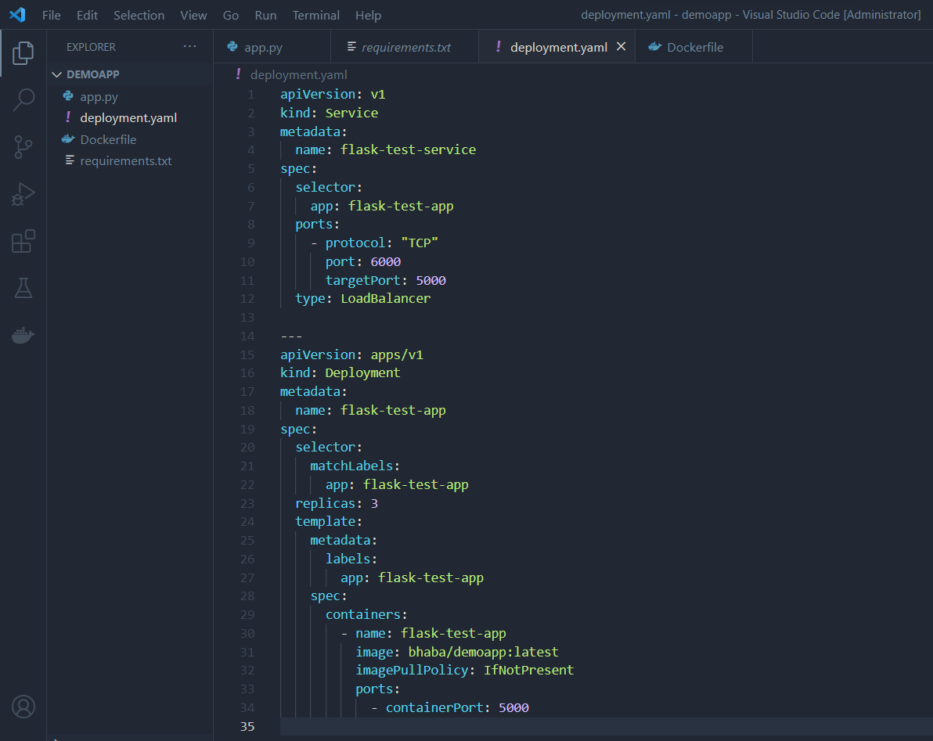
5) Create a deployment.yaml file for it.

Slide 4
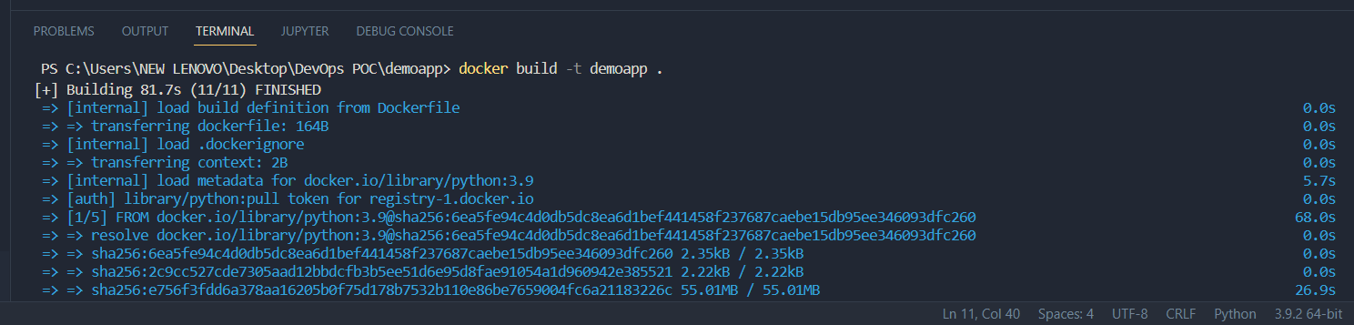
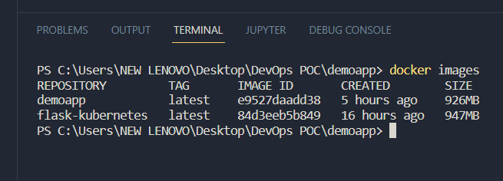
6) Run the docker build –t <image-name> . command to create a docker image of the application.
7) Run the docker images command to view the list of images created.

Slide 5
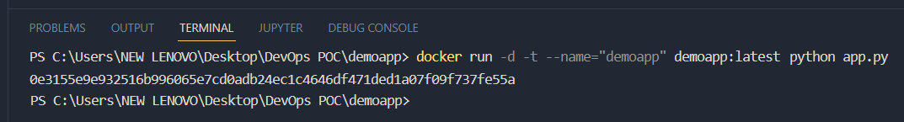
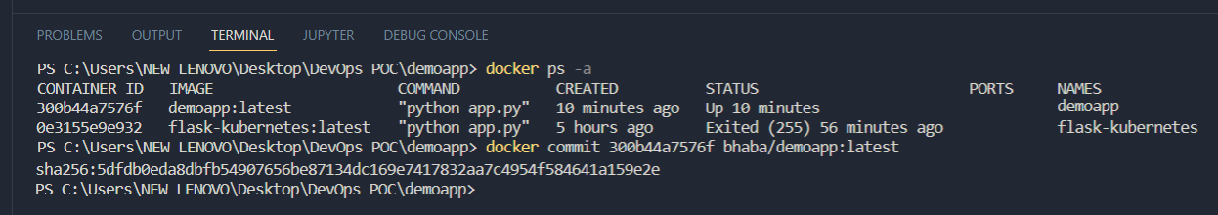
8) Run docker run –d –t –name=“< repository-name >” <repository-name>:<tag-name> python <app-name> command to create a docker container of the image.
9) Run the docker ps –a command to view the list of containers created.
10) Run docker commit <container-id> <dockerhub-username>/<image-name> command to commit the changes in the local repository.

Slide 6
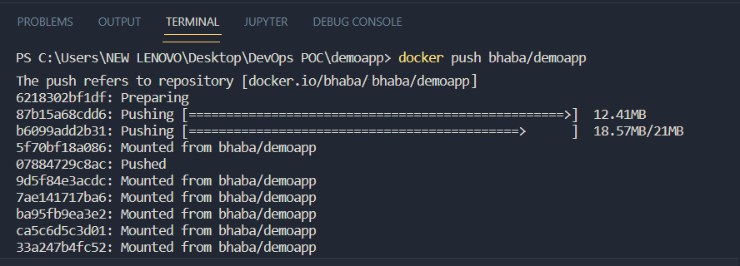
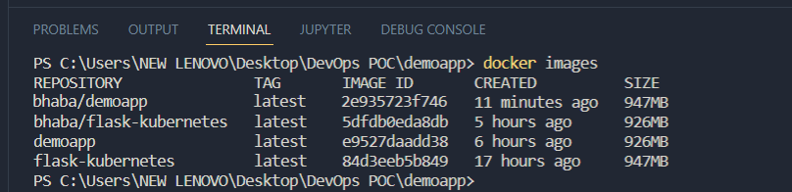
11) Run docker push <dockerhub-username>/<repository-name> command to push the image from local repository to the dockerhub central repository.
12) Run the docker images command to view and verify whether the image is created or not.

Slide 7
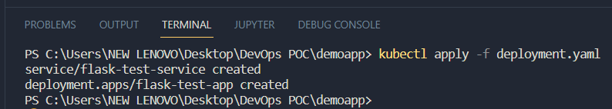
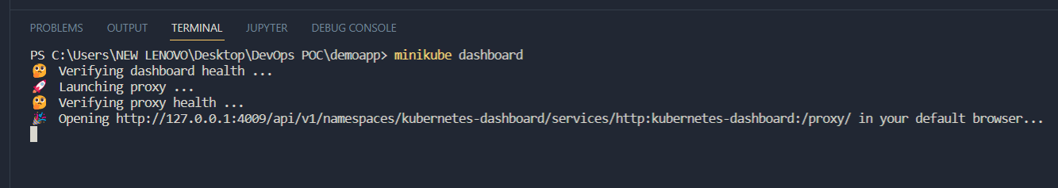
13) Run kubectl apply –f deployment.yaml command to create Kubernetes resources defined in the deployment.yaml file.
14) Run minikube dashboard command to open the Kubernetes dashboard and view the deployment.

Slide 8
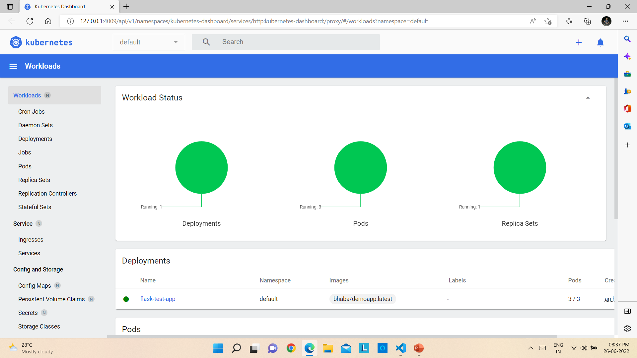
Kubernetes Dashboard

Slide 9
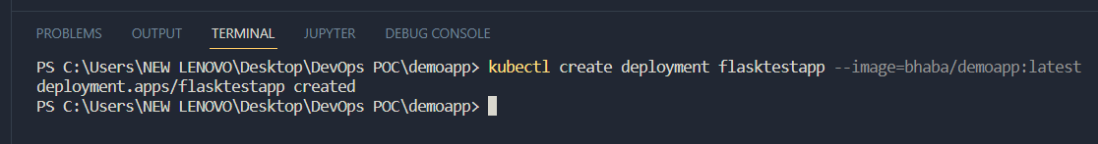
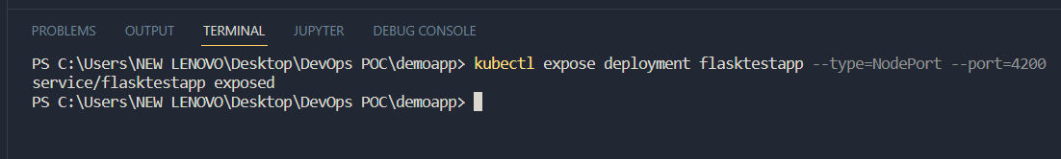
Accessing kubernetes service from outside
1) Open the folder that contains the application files in VS Code.
2) Run kubectl create deployment <service-name> --image=<image-name>:<tag-name> command to create a deployment.
3) Run kubectl expose deployment <service-name> --type=NodePort –port=4200 to expose the created Kubernetes service as a new Kubernetes service.

Slide 10
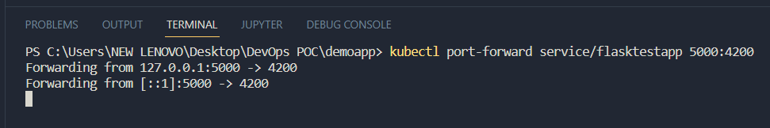
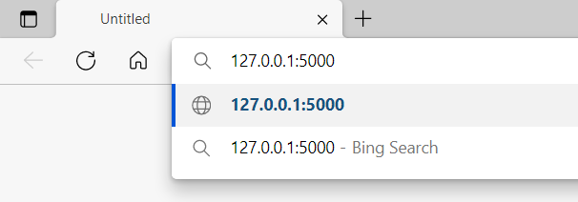
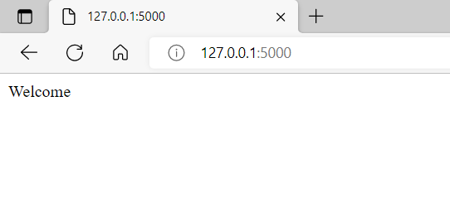
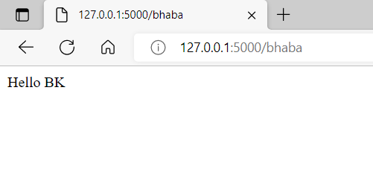
4) Run kubectl port-forward service/<service-name> 5000:4200 to set up a proxy that will forward all traffic from a local port that we specify to a port associated with the Pod that we determine.
5) Go to a browser and type 127.0.0.1:5000 as the url and press Enter to access the service.

Slide 11
Thank you !

